Slide 1
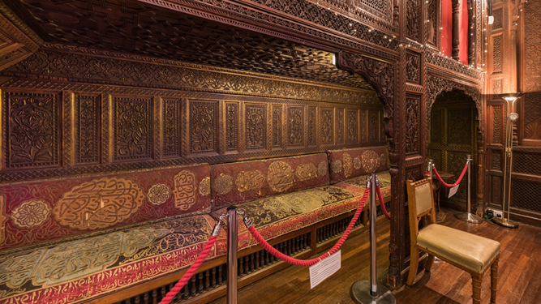
Brassey’s Brilliant Banquettes

Slide 2
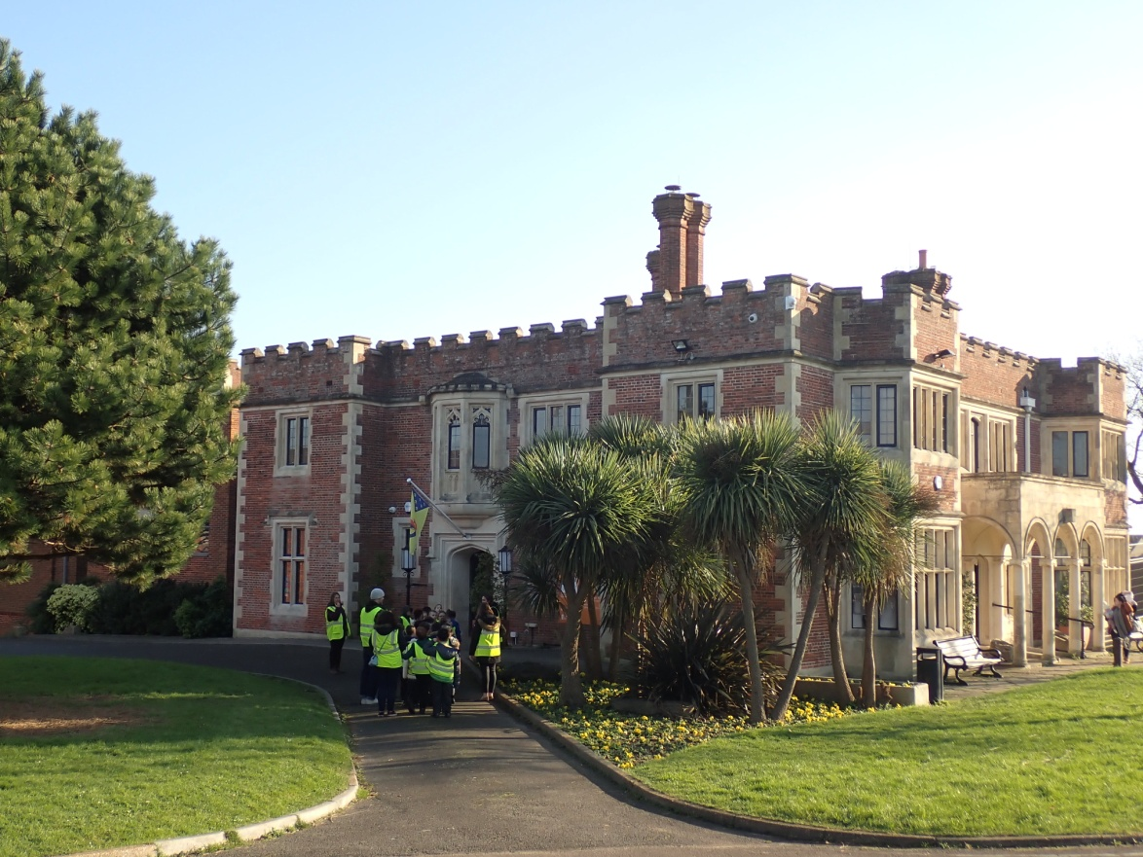
About Us
Hastings Museum & Art Gallery is a family-friendly museum with amazingly diverse collections from around the world; there really is something for everyone!

Slide 3

Our work
During the pandemic, we’ve been working closely with our community, delivering an innovative programme including online through #HastingsDigitalMuseum
We want to build on this support and use it to help preserve the museum’s collections for future generations.

Slide 4
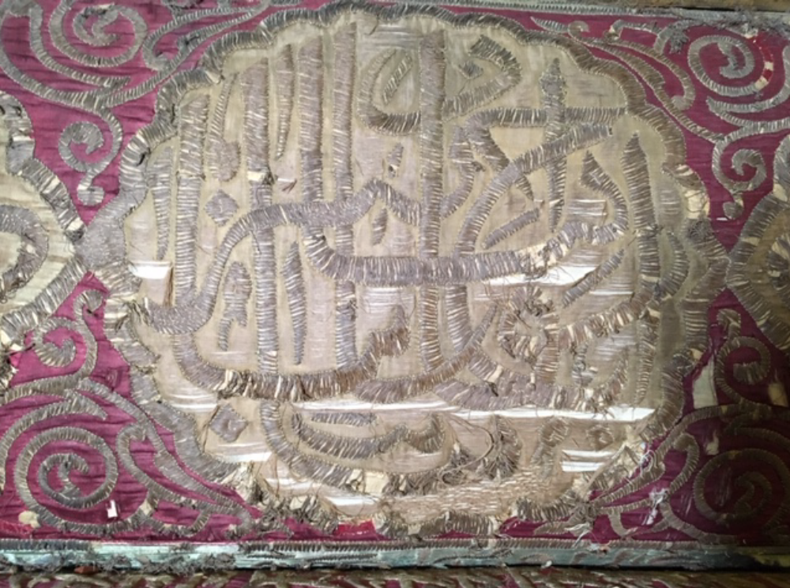
Why we need help
Our beloved banquettes have been well used over the years and are now in a very poor state. If we don’t take action soon, the material may deteriorate too far to be repaired.
This type of work is very specialist and beyond the budgets we have available.

Slide 5

What needs to happen?
The banquettes need to be cleaned and repaired by a qualified expert to show them at their best.

Slide 6
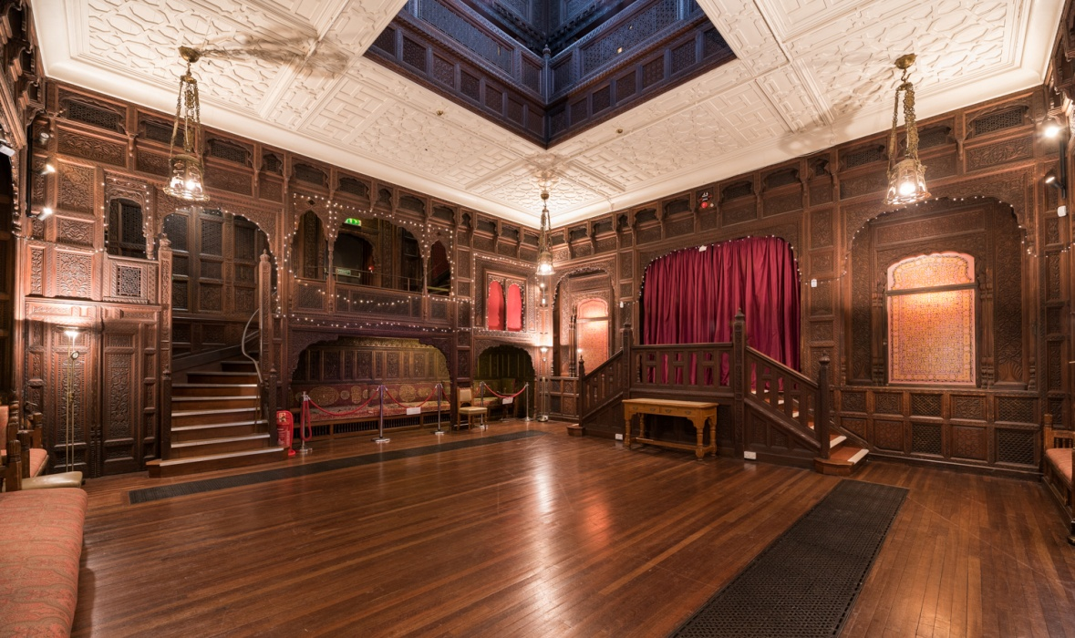
What is the Story?
The banquettes are part of the furnishings in our Durbar Hall.

Slide 7
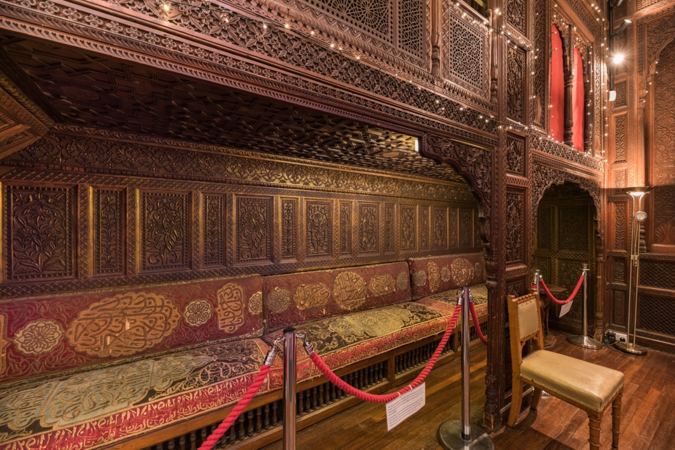
What is a banquette?
A banquette is an upholstered bench along a wall, the sort of thing you might see in a restaurant or bar.

Slide 8
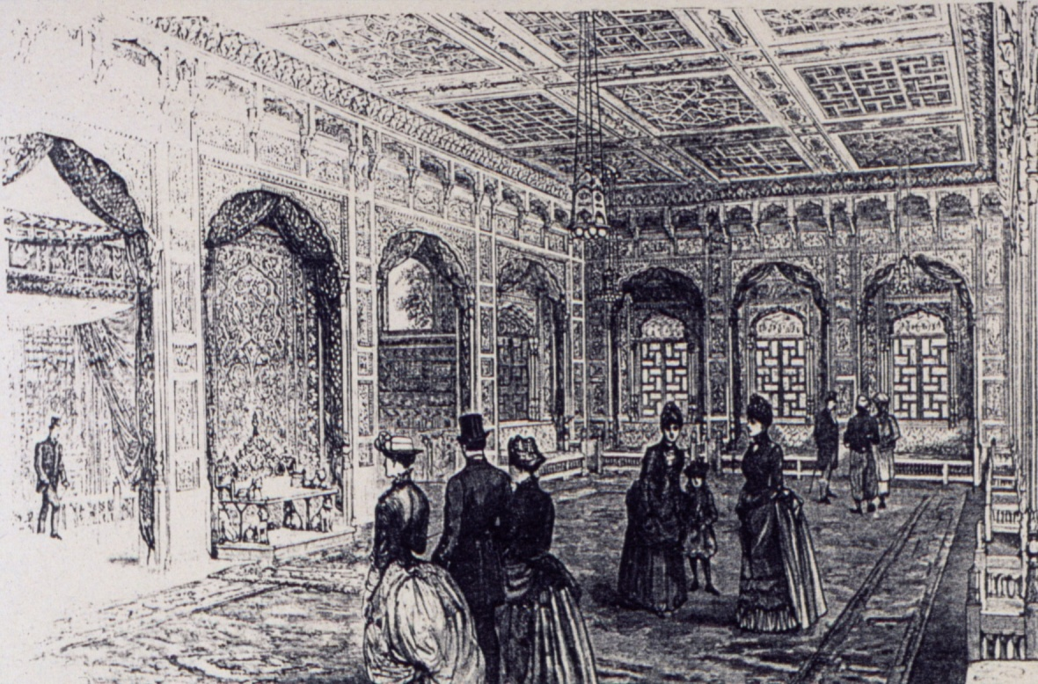
Their History
The spectacular woodcarvings and furnishings of the Durbar Hall were originally created for the Colonial & Indian Exhibition held in South Kensington, London, in 1886; within Britain it is almost unique.

Slide 9
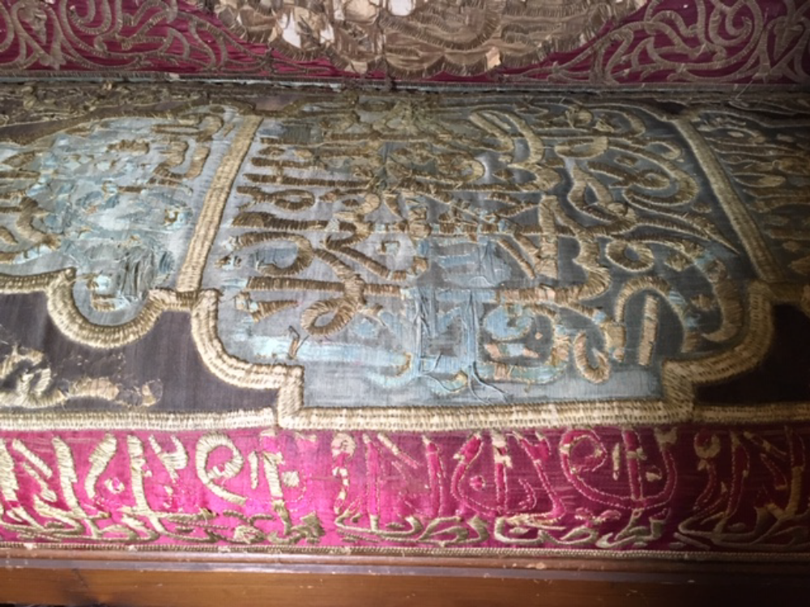
Unique Fabrics
After the Exhibition, the banquettes were re-upholstered by Lord and Lady Brassey, when the Hall was moved to their Park Lane mansion. The material they used was bought in Cairo by Annie Brassey on one of her early trips.

Slide 10
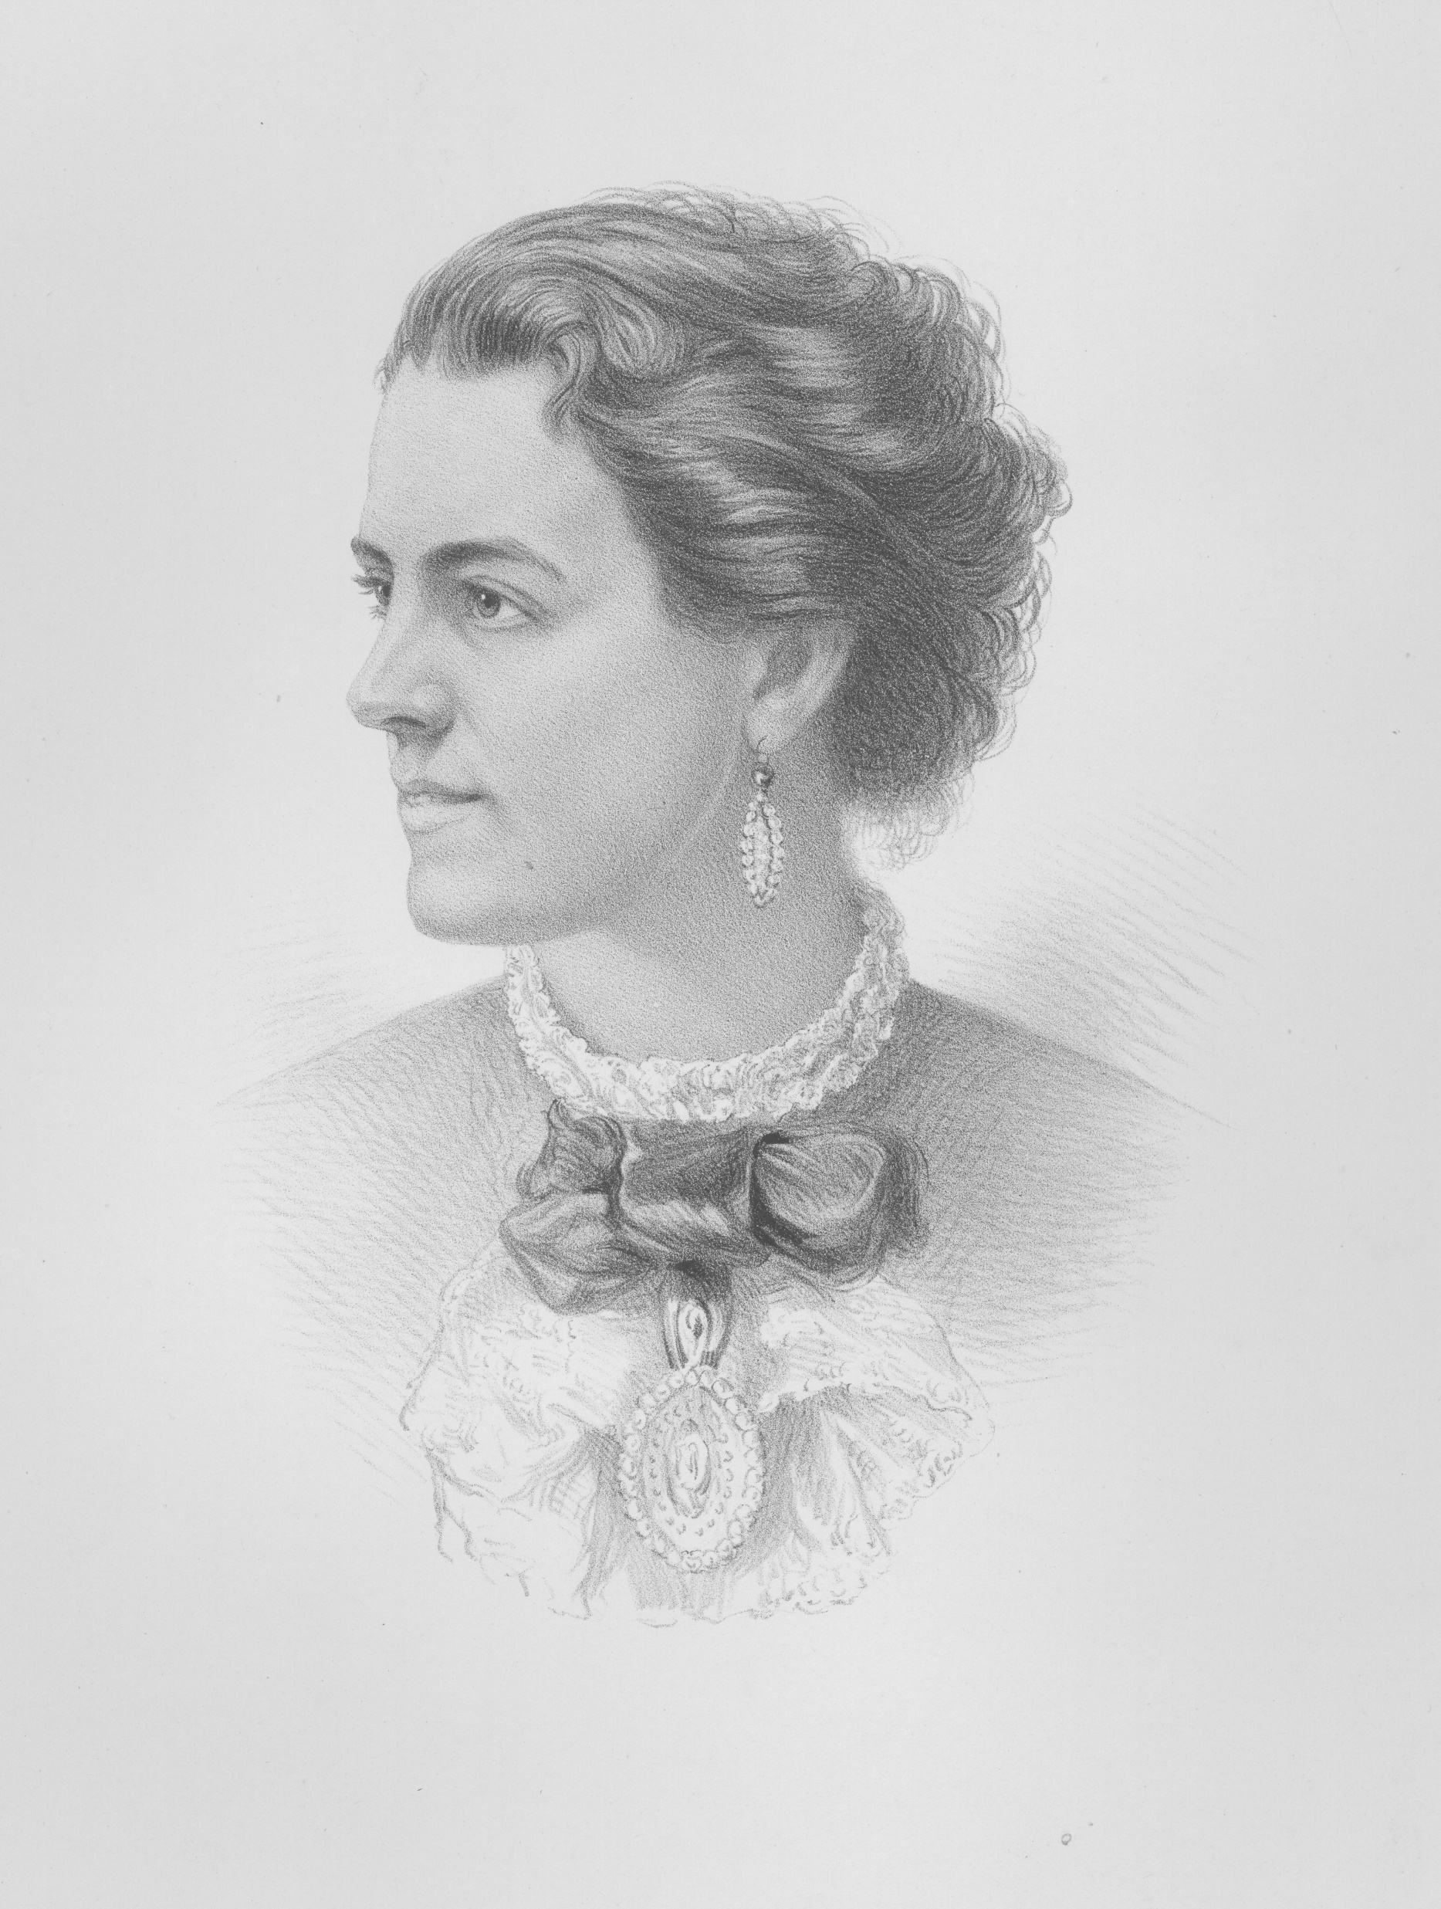
Annie Brassey
Annie was a famous early photographer, traveller and writer. The material was originally made for Sultan Abdul Aziz, the 32nd Sultan of the Ottoman Empire.

Slide 11
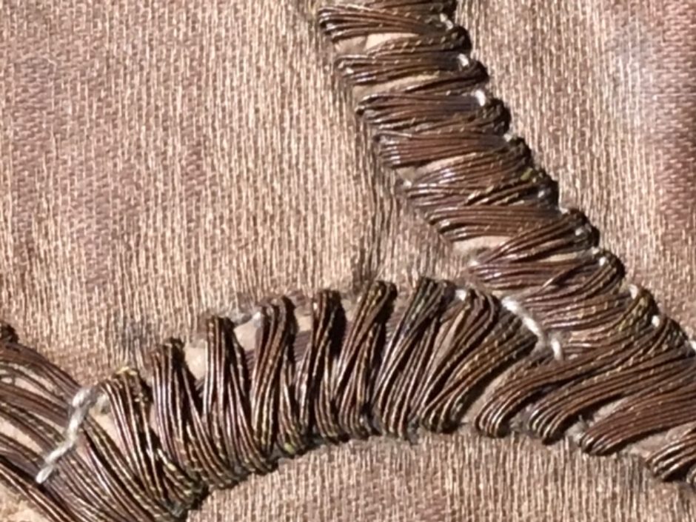
Unique Fabrics
The embroidered patterns include Arabic text set within stylized cartouches and bordered with foliate and graphic motifs. The designs are made from panels of silk and richly embroidered with metallic threads.

Slide 12
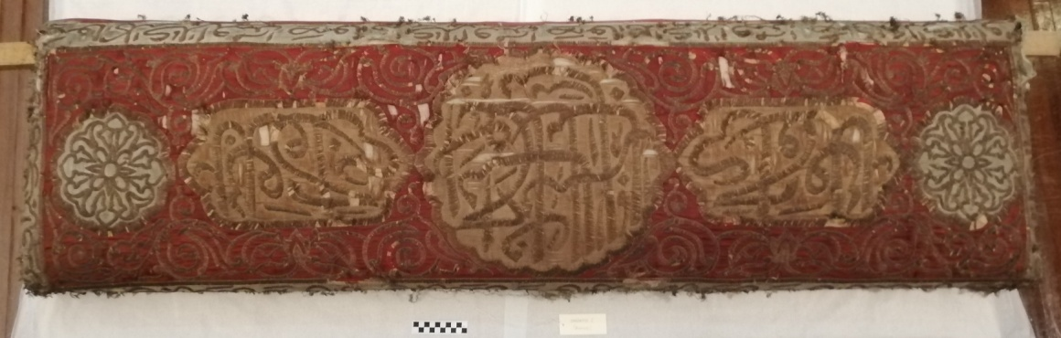
Why help us?
By helping to fund this conservation work, you will be helping the museum to preserve a rare example of craftwork of this kind.

Slide 13
Thank You
This is our first ever crowdfunding project, so we are really excited about it and wish to thank all our supporters.

Slide 14
Sources
Music
Nature by MaxKoMusic | https://maxkomusic.com/
Music promoted by https://www.free-stock-music.com
Creative Commons Attribution-ShareAlike 3.0 Unported
https://creativecommons.org/licenses/by-sa/3.0/deed.en_US
Durbar Hall Images Credit
John Fox
Conservation Report Photos
Alex Seth-Smith ACR

Slide 15


